Slide 1
Introduction to Statistics and Data Analysis I

Slide 2
Introduction to Statistics
Importance of Statistics in Data Analysis
Statistics is the science of collecting, analyzing, and interpreting data.
It plays a crucial role in decision-making across various fields.
Helps in making informed decisions, uncovering patterns, and drawing meaningful conclusions.

Slide 3
Introduction to Statistics
Importance of Statistics in Data Analysis
Statistics serves as the backbone of data analysis. It helps transform raw data into meaningful insights and actionable decisions.
Informed Decision-Making: In both business and academia, statistics is crucial for making informed decisions based on evidence rather than intuition.

Slide 4
Introduction to Statistics(contd)
Types of Data and Data Sources
Data can be categorized into two types: Qualitative (categorical) and Quantitative (numerical).
Data sources include surveys, experiments, observations, and existing datasets.

Slide 5
Introduction to Statistics(contd)
Types of Datasets - By Size
Small Datasets: Small datasets typically contain a relatively small number of data points. Can be easily analyzed using standard software tools. Examples include survey data with a few hundred responses.
Medium Datasets: Medium-sized datasets contain a moderate number of data points, making them larger and more complex than small datasets. Examples include customer records for a medium-sized business.
Big Datasets (Big Data): Big datasets are massive in size and often too large to analyze with traditional methods. They require distributed computing frameworks like Hadoop and specialized algorithms. Examples include social media data, sensor data, and financial market data.

Slide 6
Introduction to Statistics(contd)
Types of Datasets - By File Format
Structured Datasets: Structured datasets are organized in a specific format, often tabular, with well-defined rows and columns. They are commonly found in relational databases and spreadsheet files.
Unstructured Datasets: Unstructured datasets lack a predefined structure and are not organized neatly. Examples include text documents, images, audio files, and video.
Semi-structured Datasets: Semi-structured datasets have a partially defined structure. They may contain tags, labels, or metadata that provide some organization. Examples include XML and JSON files.

Slide 7
Introduction to Statistics(contd)
Types of Datasets - By Nature
Cross-Sectional Datasets: Cross-sectional datasets capture information at a single point in time. Each data point represents a different entity or individual. For example, a survey conducted on a specific day to collect information about various individuals.
Time Series Datasets: Time series datasets record data over a continuous period, typically at regular intervals (e.g., daily, monthly, yearly). They are used to analyze trends and patterns over time, such as stock prices, weather data, or economic indicators.
Panel or Longitudinal Datasets: Panel datasets track the same set of entities or individuals over multiple time periods. They are valuable for studying changes and developments over time, such as tracking the performance of students in a school over several years.

Slide 8
Introduction to Statistics(contd)
Data Visualization Techniques
Data visualization techniques, such as bar charts, scatterplots, and heatmaps, are essential for representing data visually. They make complex data more understandable and can reveal patterns and trends that might not be evident in raw numbers.
Helps in understanding data patterns and trends quickly.

Slide 9
Introduction to Statistics(contd)
Business and Data Analysis
In the business world, data analysis plays a central role in decision-making. It helps organizations optimize processes, identify market trends, and gain a competitive edge.

Slide 10
Introduction to Statistics(contd)
Understanding Data in Analytics
Data analytics involves examining large datasets to uncover insights.
It includes techniques like data mining, predictive modeling, and machine learning.

Slide 11
Introduction to Statistics(contd)
Business Analyst Job Description
Business analysts are professionals who bridge the gap between data analysis and business objectives. Their responsibilities include:
Gathering and interpreting data.
Developing actionable recommendations.
Supporting decision-makers in implementing data-driven strategies.

Slide 12
Introduction to Statistics(contd)
Descriptive vs. Inferential Statistics
Descriptive Statistics: Descriptive statistics summarize and describe data. It includes measures like mean, median, and standard deviation, which provide insights into the data's central tendencies and variability.
Inferential Statistics: Inferential statistics allow us to make predictions or inferences about a population based on a sample. This is vital when it's impractical to analyze an entire dataset.

Slide 13
Calculating Probability
Basic Probability Concepts
Probability measures the likelihood of an event occurring.
It ranges from 0 (impossible) to 1 (certain).
Events can be independent or dependent.

Slide 14
Calculating Probability(contd)
Probability Formula
Probability = (Number of Favorable Outcomes) / (Total Number of Outcomes)
Used to calculate the likelihood of an event happening.

Slide 15
Calculating Probability(contd)
Probability Distributions: Probability distributions describe the possible outcomes of a random variable. Common distributions include:
Normal distribution (bell curve)
Binomial distribution (two possible outcomes)
Poisson distribution (count of rare events)

Slide 16
Calculating Probability(contd)
Axioms of Probability
Axiom 1: Probability is always between 0 and 1.
Axiom 2: The probability of the entire sample space is 1.
Axiom 3: The probability of mutually exclusive events is additive.

Slide 17
Calculating Probability(contd)
Probability Tree
A probability tree is a visual tool for calculating probabilities in a sequence of events.
Useful for solving complex probability problems involving multiple steps.

Slide 18
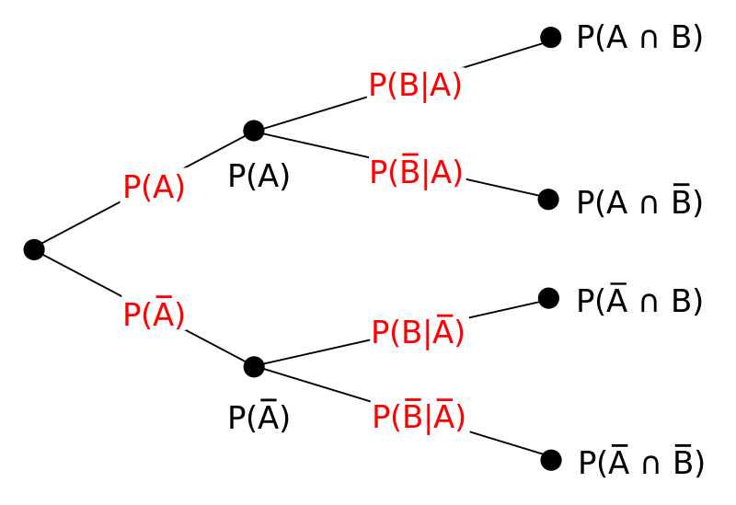
Calculating Probability(contd)
Probability Tree

Slide 19
Conclusion
Statistics and data analysis are essential for informed decision-making.
Understanding probability is key to analyzing uncertain situations.
These concepts are fundamental in various fields, including business, science, and technology.

Slide 20
Thank you!

